Slide 1
Section 9.1
Infinite Series: “Sequences”

Slide 2
All graphics are attributed to:
Calculus,10/E by Howard Anton, Irl Bivens, and Stephen Davis
Copyright © 2009 by John Wiley & Sons, Inc. All rights reserved.”

Slide 3
Introduction
In this chapter, we will be dealing with infinite series which are sums that involve infinitely many terms.
We can use them for many things such as approximating trig functions and logarithms, solving differential equations, evaluating difficult integrals, constructing mathematical models of physical laws, and more.
Since it is impossible to add up infinitely many numbers directly, we must define exactly what we mean by the sum of an infinite series.
Also, it is important to realize that not all infinite series actually have a sum so we will need to find which series do have sums and which do not.

Slide 4
“Sequence” – everyday vs. mathematical applications
In everyday language, the term “sequence” means a succession of things in a definite order – chronological order, size order, or logical order.
In mathematics, the term “sequence” is commonly used to denote a succession of numbers whose order is determined by a rule or a function.

Slide 5
Definitions and Examples
Infinite sequence – an unending succession of numbers called terms.
Terms – numbers that have a definite order; first term a₁, second term a₂, third term a₃, fourth term a₄, and so on. They are often written a_{1,} a_{2,} a_{3,} a_{4,} …, where the … indicates that the sequence continues indefinitely.
Easy examples pattern general term
  1,2,3,4,… add one n
  2,4,6,8,… multiply by 2 2n
  1,-1,1,-1,… alternating +/- (-1) ^{n-1}

Slide 6
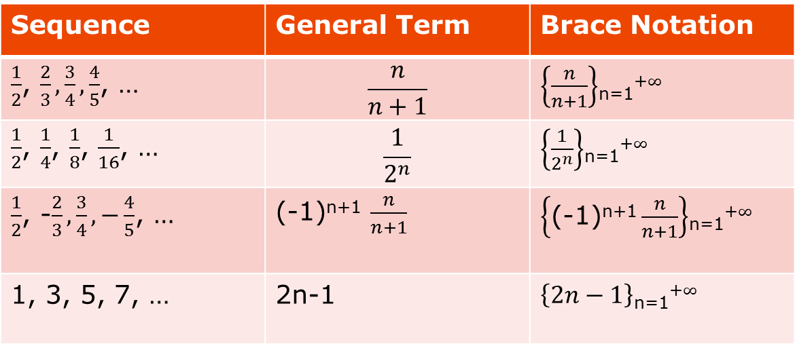
Example with Brace Notation
Sequence | General Term | Brace Notation
$\frac{1}{2}$, $\frac{2}{3}, \frac{3}{4}, \frac{4}{5}$, … | $$\frac{n}{n+1}$$ | $\left\{\frac{n}{n+1}\right\}$_{n=1}⁺$∞$
$\frac{1}{2}$, $\frac{1}{4}$, $\frac{1}{8}$, $\frac{1}{16}$, … | $$\frac{1}{2^{n}}$$ | $\left\{\frac{1}{2^{n}}\right\}$_{n=1}⁺$∞$
$\frac{1}{2}$, -$\frac{2}{3}, \frac{3}{4}, −\frac{4}{5}$, … | (-1)^{n+1} $\frac{n}{n+1}$ | $\left\{\text{(−1)}\text{n}\text{+1}\frac{n}{n+1}\right\}$_{n=1}⁺$∞$
1, 3, 5, 7, … | 2n-1 | $\left\{2n−1\right\}$_{n=1}⁺$∞$

Slide 7
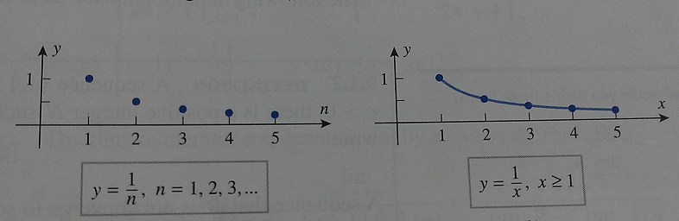
Graphs of Sequences
Since sequences are functions, we will sometimes graph the sequence.
Because the term numbers in the sequence below y = 1/n are integers, the graph consists of a succession of isolated points instead of a continuous curve like y = 1/x would be if you were not graphing a sequence.

Slide 8
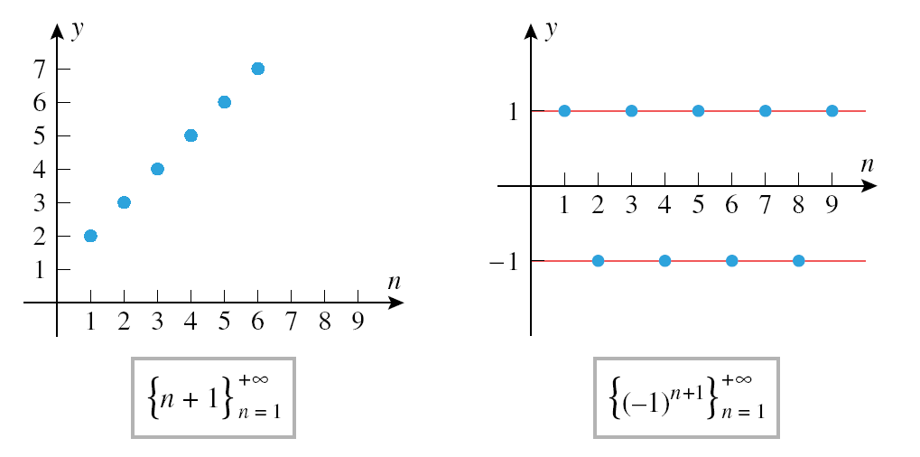
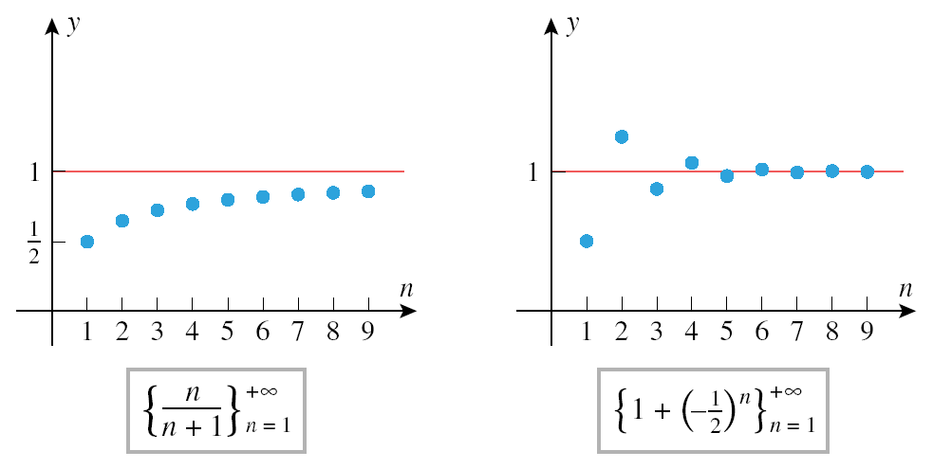
Limits of a Sequence
Since sequences are functions, we can discuss their limits.
However, because a sequence is only defined for integer values, the only limit that makes sense is the limit of a_{n} as n approaches infinity.
Examples:
Tends toward a “limiting value” of 1 in an oscillatory fashion (CONVERGE)
Increases without bound (DIVERGE)
Oscillates between -1 and 1 (DIVERGE)
Increases toward a “limiting value” of 1 (CONVERGE)

Slide 9
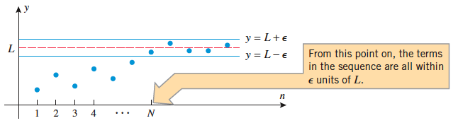
Limits of a Sequence con’t
Informally speaking, the limit of a sequence {a_{n}} is intended to describe how a_{n} behaves as n approaches infinity.
More specifically, we will say that a sequence {a_{n}} approaches a limit L if the terms in the sequence eventually become arbitrarily close to L (see picture below and definition on following slide).

Slide 10
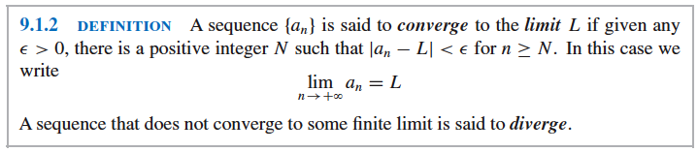
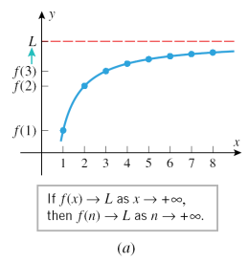
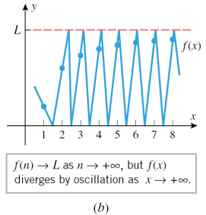

Converge and Diverge
Look back at the examples on slide #8 to see which converge, which diverge, and why.
If the general term of a sequence is f(n), where f(x) is a function defined on the entire interval [1,$+∞)$, then the values of f(n) can be viewed as “sample values” of f(x) taken at the positive integers. Thus,
  if f(x) L as x $+∞$, then f(n) L as n $+∞$
However, the converse is not true. You cannot infer the same about f(x) given f(n).

Slide 11
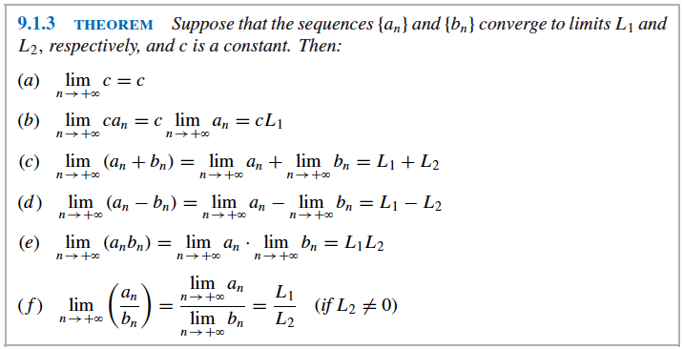
Familiar Properties of Limits Apply to Sequences ☺

Slide 12

Converge or Diverge Examples
To determine whether the following sequences converge or diverge, we will examine the limit as n approaches $∞.$
a) $\left\{\frac{n}{2n+1}\right\}$_{n=1}⁺$∞$
  Solution: Divide the numerator and denominator by the highest power of n in the denominator (like chapter 1).
  $\lim_{n→+∞}{\frac{n}{2n+1}}$ = $\lim_{n→+∞}{\frac{n/n}{(2n+1)/n}}$ = $\frac{\lim_{n→+∞}{1}}{\lim_{n→+∞}{(2+\frac{1}{n})}}$ = $\frac{1}{2+0}$ = $\frac{1}{2}→$converges
b) $\left\{\text{(−1)}\text{n}\text{+1}\frac{n}{2n+1}\right\}$_{n=1}⁺$∞$
  Solution: This is the same as a) except the $\text{(−1)}\text{n}\text{+1}$ makes it oscillate between -1 and 1 times the answer we got in a). Therefore, the odd-numbered terms approach $\frac{1}{2}$ and the even-numbered terms approach - $\frac{1}{2}$and the sequence diverges.

Slide 13

Converge or Diverge Examples con’t
c) $\left\{\text{(−1)}\text{n}\text{+1}\frac{1}{n}\right\}$_{n=1}⁺$∞$
  Solution: Like in b), the $\text{(−1)}\text{n}\text{+1}$ makes this oscillate between positives and negatives. However, the 1/n approaches 0. Therefore, the terms approach 0 from both sides, making the limit 0. $→$ converges to 0
d) {8 – 2n} _{n=1}⁺$∞$
  Solution: $\lim_{n→+∞}{\text{(}\text{8 – 2}\text{n}\text{)}}$ = -$∞$ by end behavior or graphing. Therefore, the sequence diverges.
See example #4 on page 601 for more sequences.

Slide 14

Limit Example Using L’Hopital’s Rule
Find the limit of the sequence {$\frac{n}{e^{n}}$} _{n=1}⁺$∞$
Solution: $\lim_{n→+∞}{\frac{n}{e^{n}}}$ = $\frac{∞}{∞}$ which is indeterminate form.
Therefore, we will use L’Hopital’s rule where you take the derivative of the top and bottom separately and then evaluate the limit.
$\lim_{n→+∞}{\frac{n}{e^{n}}}$ = $\lim_{x→+∞}{\frac{x}{e^{x}}}$ = $\lim_{x→+∞}{\frac{1}{e^{x}}}$ = $\frac{1}{+∞}$ = 0 $→\lim_{n→+∞}{\frac{n}{e^{n}}}$ = 0

Slide 15

Another Limit Example Using L’Hopital’s Rule
Show that the $\lim_{n→+∞}{\sqrt[n]{n}}$
Solution:$\lim_{n→+∞}{\sqrt[n]{n}}$ = $∞^{\frac{1}{∞}}$ =${ ∞}^{0}$ which is indeterminate form
Therefore, we will use L’Hopital’s rule.
The problem is that we do not currently have a fraction so we have some work to do first to get a fraction.
$\lim_{n→+∞}{\sqrt[n]{n}}$ = $\lim_{n→+∞}{n^{\frac{1}{n}}}$ = $\lim_{n→+∞}{e^{lnn^{\frac{1}{n}}}}$ by the inverse property
= $\lim_{n→+∞}{e^{\frac{1}{n}lnn}}$ by the power property
= $\lim_{n→+∞}{e^{\frac{lnn}{n}}}$ = $e^{\lim_{n→+∞}{\frac{lnn}{n}}}$ = $e^{\lim_{n→+∞}{\frac{\frac{1}{n}}{1}}}$ = $e^{\frac{\frac{1}{+∞}}{1}}$ = $e^{0}$ = 1

Slide 16
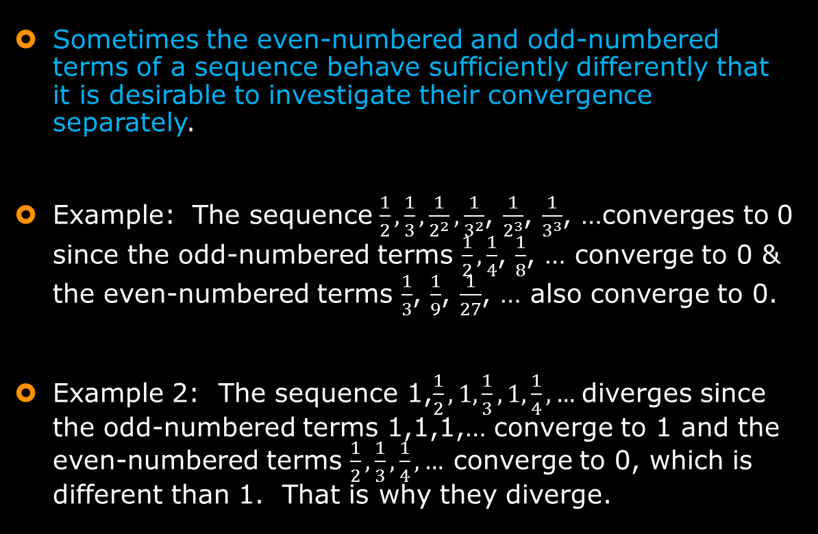
Example Looking at Even-Numbered Terms and Odd-Numbered Terms Separately
Sometimes the even-numbered and odd-numbered terms of a sequence behave sufficiently differently that it is desirable to investigate their convergence separately.
Example: The sequence $\frac{1}{2}, \frac{1}{3}, \frac{1}{2^{2}}, \frac{1}{3^{2}}$, $\frac{1}{2^{3}}$, $\frac{1}{3^{3}}$, …converges to 0 since the odd-numbered terms $\frac{1}{2},\frac{1}{4}$, $\frac{1}{8}$, … converge to 0 & the even-numbered terms $\frac{1}{3}$, $\frac{1}{9}$, $\frac{1}{27}$, … also converge to 0.
Example 2: The sequence 1,$\frac{1}{2}, 1,\frac{1}{3}, 1,\frac{1}{4},…$ diverges since the odd-numbered terms 1,1,1,… converge to 1 and the even-numbered terms $\frac{1}{2}, \frac{1}{3}, \frac{1}{4},…$ converge to 0, which is different than 1. That is why they diverge.

Slide 17
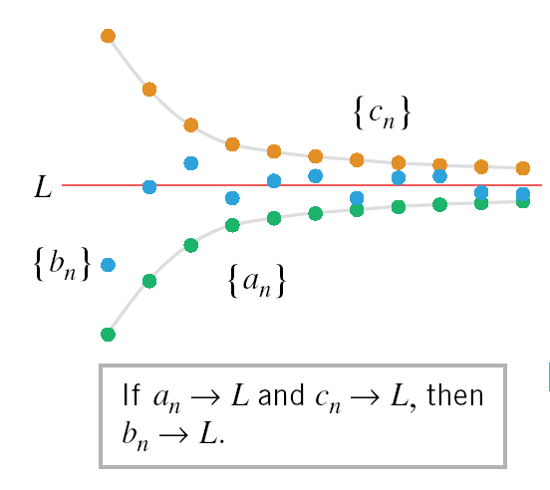
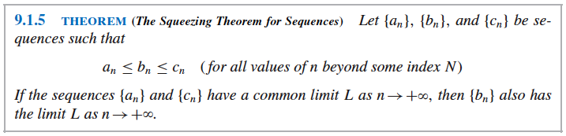
The Squeezing Theorem for Sequences
This idea is very similar to the squeezing theorem we learned in chapter 1 for trigonometry limits.
We will use it to find limits of sequences that cannot be directly obtained and must therefore be compared to other sequences and “squeezed” between them.

Slide 19

Rocksanna at Mono Lake

